Slide 1
Ggplot2 and interactive graphics with R
Christophe Ladroue
SECTION 07
Making interactive webpages with ‘shiny’ 2/2
www.PacktPub.com

Slide 2
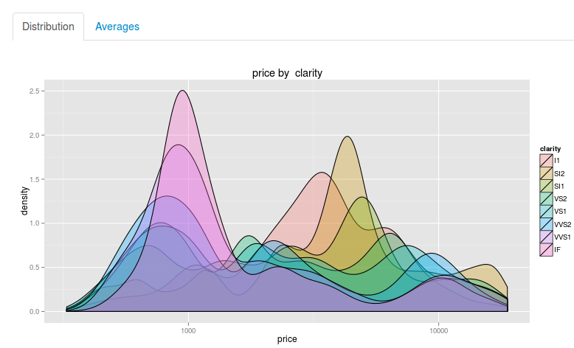
In this video we took a look at
how to use tabs to separate different portions of our interactive reports. This is very useful to build complex dashboards with multiple graphs and textual reports.
Next: understanding scoping

Slide 3
In this section we’re going to take a look at
Creating and using tabs.
Understanding scoping.
Uploading a file.
Downloading a file.
Sharing your work.

